Slide 1

A HYBRID SIMULATION-BASED APPROACH FOR ADAPTIVE PRODUCTION AND DEMAND MANAGEMENT IN COMPETITIVE MARKETS
Paper ID: con124
Paper ID: con318
Presented By,
S M Atikur Rahman
Advisor,
Dr Md. Fashiar Rahman

Slide 2
Contents
Introduction
Contribution
problem description
Model description
Experimentation
Results and analysis
Conclusion
Limitations & implication’s
Acknowledgement

Slide 3
Introduction
In today’s dynamic market environment, businesses must continuously adapt to fluctuations in demand, competitive pressures, and operational constraints to maintain efficiency and profitability.
Traditional production planning methods often rely on static models that fail to account for real-time market influences, leading to inefficiencies in inventory management and demand forecasting.
To address these challenges, this study leverages a hybrid simulation approach that integrates SD and DES to optimize market-driven production planning.
DES is widely used in manufacturing systems to model production processes, inventory management, and supply chain dynamics. It captures discrete events such as order arrivals, production cycles, and inventory restocking, making it suitable for simulating operational workflows with high granularity.
However, DES alone does not account for the behavioral and market-driven factors influencing demand. On the other hand, SD provides a macro-level approach to understanding complex interdependencies between market variables, such as customer adoption, promotional influences, and competitive market dynamics.
By combining these two simulation paradigms, this study presents a comprehensive framework for modeling production and inventory while dynamically responding to demand fluctuations.

Slide 4
Contribution of the Study
The specific contribution of this study is given below:
Developed a comprehensive framework to transform a low-demand edible oil into a high-demand product by optimizing marketing parameters, such as advertising strategies, pricing models, and consumer engagement.
Illustrate a hybrid simulation method that captures the product’s life cycle behavior and supports sustained demand at the maturity stage through a dynamic marketing strategy.
Perform multi-scenario experimentation to evaluate the impact of various influencing factors on the market growth and profit gain.

Slide 5
Comparative Analysis

Slide 6
Problem Description
The market demand for edible oil products fluctuates frequently due to their limited shelf life and changing consumer preferences.
To maintain sales within the product’s lifetime, businesses must continually adjust sales strategies, promotional activities, and advertising efforts. Unlike durable goods, edible oil products require a highly responsive marketing approach to ensure steady sales and prevent excess inventory or stockouts.
Traditional demand forecasting models have proven ineffective in capturing the dynamic nature of consumer adoption and external market influences.
Upon analyzing competitor products from other existing companies, we identified the critical factors that influence advertising effectiveness, contact rate, contact effect, and credibility.
This study presents a hybrid simulation model that combines Discrete Event Simulation (DES) for production output and System Dynamics (SD) for demand forecasting. The model dynamically adjusts key parameters to support sustained demand growth.

Slide 7
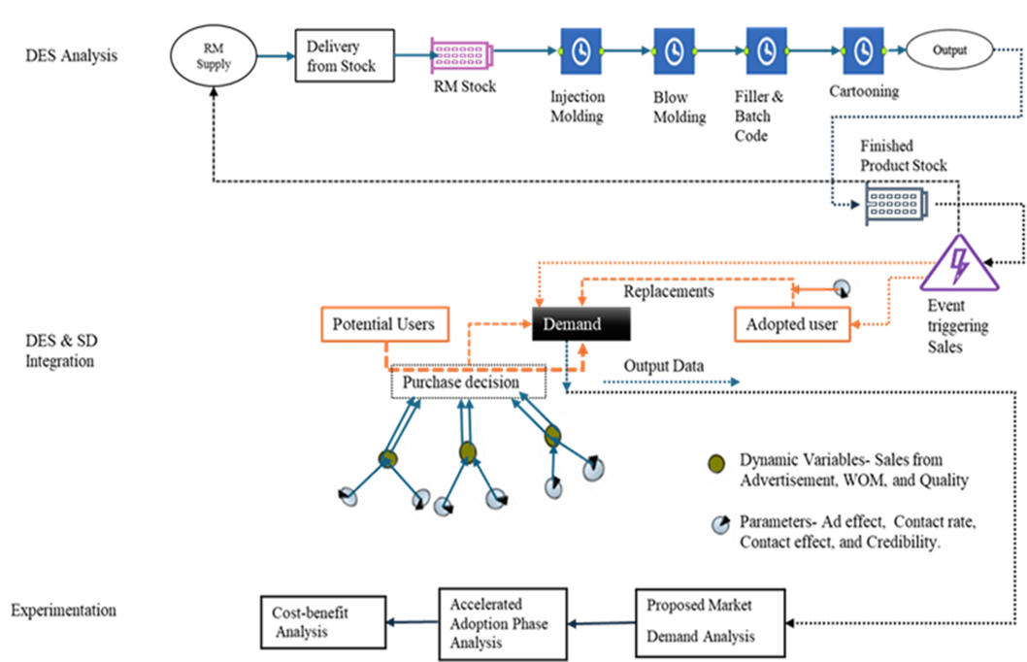
Methodology
DES model for production operations,
SD model for demand analysis by capturing the market dynamics, and
Experimentation with different system boundaries and parameters.
Methodology framework for hybrid simulation.

Slide 8
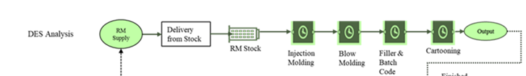
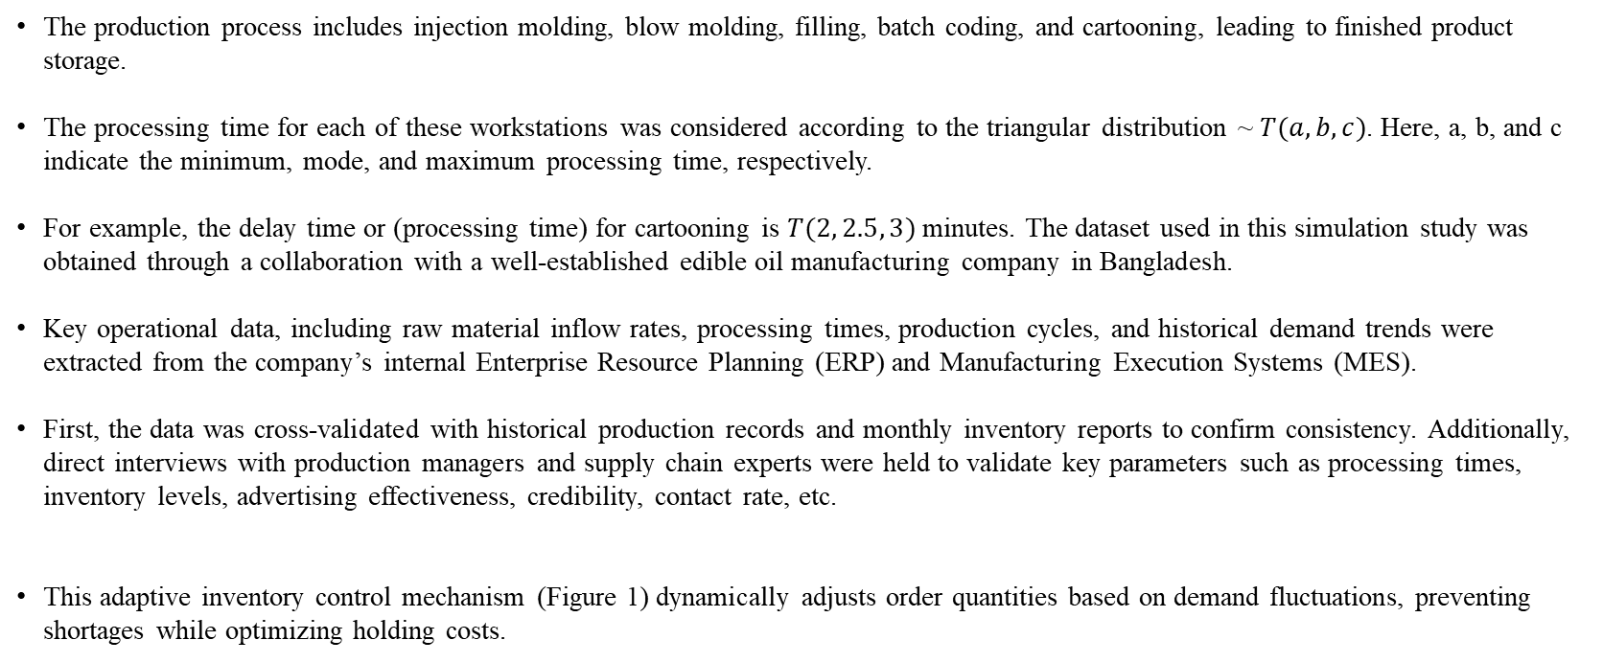
Methodology
Step 1
The production process includes injection molding, blow molding, filling, batch coding, and cartooning, leading to finished product storage.
The processing time for each of these workstations was considered according to the triangular distribution ~ $T(a,b,c)$. Here, a, b, and c indicate the minimum, mode, and maximum processing time, respectively.
For example, the delay time or (processing time) for cartooning is $T(2, 2.5, 3)$ minutes. The dataset used in this simulation study was obtained through a collaboration with a well-established edible oil manufacturing company in Bangladesh.
Key operational data, including raw material inflow rates, processing times, production cycles, and historical demand trends were extracted from the company’s internal Enterprise Resource Planning (ERP) and Manufacturing Execution Systems (MES).
First, the data was cross-validated with historical production records and monthly inventory reports to confirm consistency. Additionally, direct interviews with production managers and supply chain experts were held to validate key parameters such as processing times, inventory levels, advertising effectiveness, credibility, contact rate, etc.
This adaptive inventory control mechanism (Figure 1) dynamically adjusts order quantities based on demand fluctuations, preventing shortages while optimizing holding costs.

Slide 9
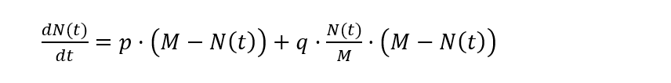
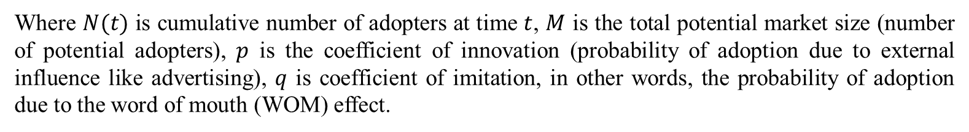
Methodology
Step 2
For analyzing the behavior of these variables, we apply the Bass diffusion model (Santa-Eulalia et al. 2011) into this SD simulation using the Equation (1) for getting the information on the coefficient of innovation & imitation in our model:
Where $N(t)$ is cumulative number of adopters at time $t$, $M$ is the total potential market size (number of potential adopters), $p$ is the coefficient of innovation (probability of adoption due to external influence like advertising), $q$ is coefficient of imitation, in other words, the probability of adoption due to the word of mouth (WOM) effect.

Slide 10
Methodology
Step 2 continued…
Market Dynamics Simulation Algorithm

Slide 11
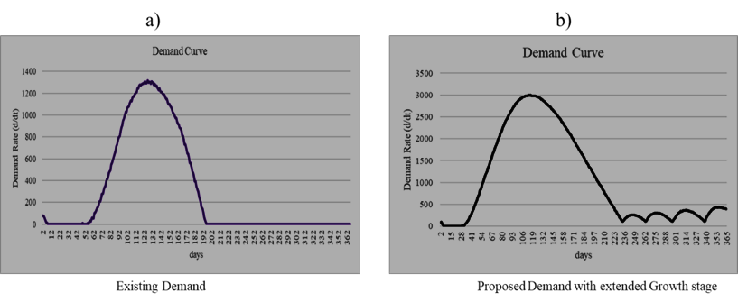
Experimental Analysis.
In the beginning, PotentialUsers stabilized at a rate the user required to reflect short-term market recovery due to promotional efforts and credibility gains.
For example, we consider at least 1000 potential users after the first few days. However, once these days have passed, PotentialUsers begin to decline until they reach close to zero.
This gradual decline represents the long-term decay in the market impact, where initial boosts in market penetration fade over time.
By incorporating stochastic variations in key parameters, the model captures the cyclical nature of demand.
This provides a realistic simulation of customer acquisition, retention, and market shrinkage due to reduced credibility and advertising effectiveness.
Demand Curve analysis.

Slide 12
Results & Analysis.
The analysis includes 1) the effects of the parameters’ variation and their impact on profitability,
and 2) an optimization experiment to select the best possible combination of parameters that ensures the most profitability.

Slide 13
Results & Analysis.
The optimization process steadily improved results, with profits increasing sharply in the first 100 iterations, before stabilizing at approximately $53,000-$54,000 in later stages.
This suggests that the algorithm efficiently converged to an optimal solution, ensuring that further adjustments yielded minimal improvements.
The best feasible solution demonstrates how systematic parameter tuning resulted in a stable and optimized inventory strategy, ultimately maximizing profitability.
Experimental analysis- a) Profit from compare runs and, b) Parameter optimization from optimization experiments.

Slide 14
Conclusion
This paper presents a simulation-based approach for optimizing production operations by considering demand and market dynamics, specifically tailored for the edible oil industry.
Leveraging this hybrid method, companies can explore and evaluate various marketing strategies, assess the effects of influencing factors, and anticipate demand fluctuations without making immediate adjustments to their actual systems.
Unlike traditional forecasting methods that struggle to capture dynamic consumer behavior and shifting market conditions, this hybrid simulation approach offers a reliable and insightful platform for strategic decision-making.
In an increasingly competitive marketplace, this method allows companies to respond swiftly to changes, reduce operational risks, and maintain consistent market presence while minimizing costs and inefficiencies.

Slide 15
Limitations
Although our optimization experiments successfully identified the optimal inventory management strategy, several avenues remain open for future exploration.
Incorporating seasonal variations in demand and dynamic lead-time fluctuations could significantly enhance the model's adaptability to real-world uncertainties.
Furthermore, external validation across diverse market scenarios and varied cost structures would improve the robustness and generalizability of the findings.

Slide 16
Practical Implications
By deploying the hybrid simulation framework integrating DES and SD, managers can proactively evaluate strategic adjustments in production and marketing, effectively aligning operations with consumer demand patterns.
The real-time analysis capability of the model enables swift responses to sudden shifts in market trends, minimizing stockouts and surplus inventory.
This predictive approach supports efficient resource allocation and helps businesses avoid unnecessary costs associated with excess production or inventory shortages.
Additionally, the method allows firms to experiment with marketing scenarios virtually, significantly reducing the financial and operational risks linked to untested promotional campaigns.

Slide 17
Acknowledgement
This work was partially supported by the United States (U.S.) National Science Foundation (IUSE 2216396) and the U.S. Department of Education (FIPSE P116S210004, MSEIP P120A220044). The authors wish to express sincere gratitude for their financial support.

Slide 18


Slide 19
THANK YOU
Question and Discussion

